Slide 1

CMR COLLEGE OF ENGINEERING & TECHNOLOGY
Kandlakoya, Medchal, Hyderabad - 501401
Department of Computer Science and Engineering
RIDER HELMET DETECTION FOR FUEL FILLING
Under the Guidance of:
B. Gayathri (Assistant Professor)
Team 05:
D. Sathish
C. Srikanth
J. Pooja
20H55A0505
20H55A0501
20H55A0512

Slide 2
Outline
Abstract
Introduction
Objective
Scope & Limitations
Problem Definition
Existing Methods
Data Collection & Performance Metrics Study

Slide 3
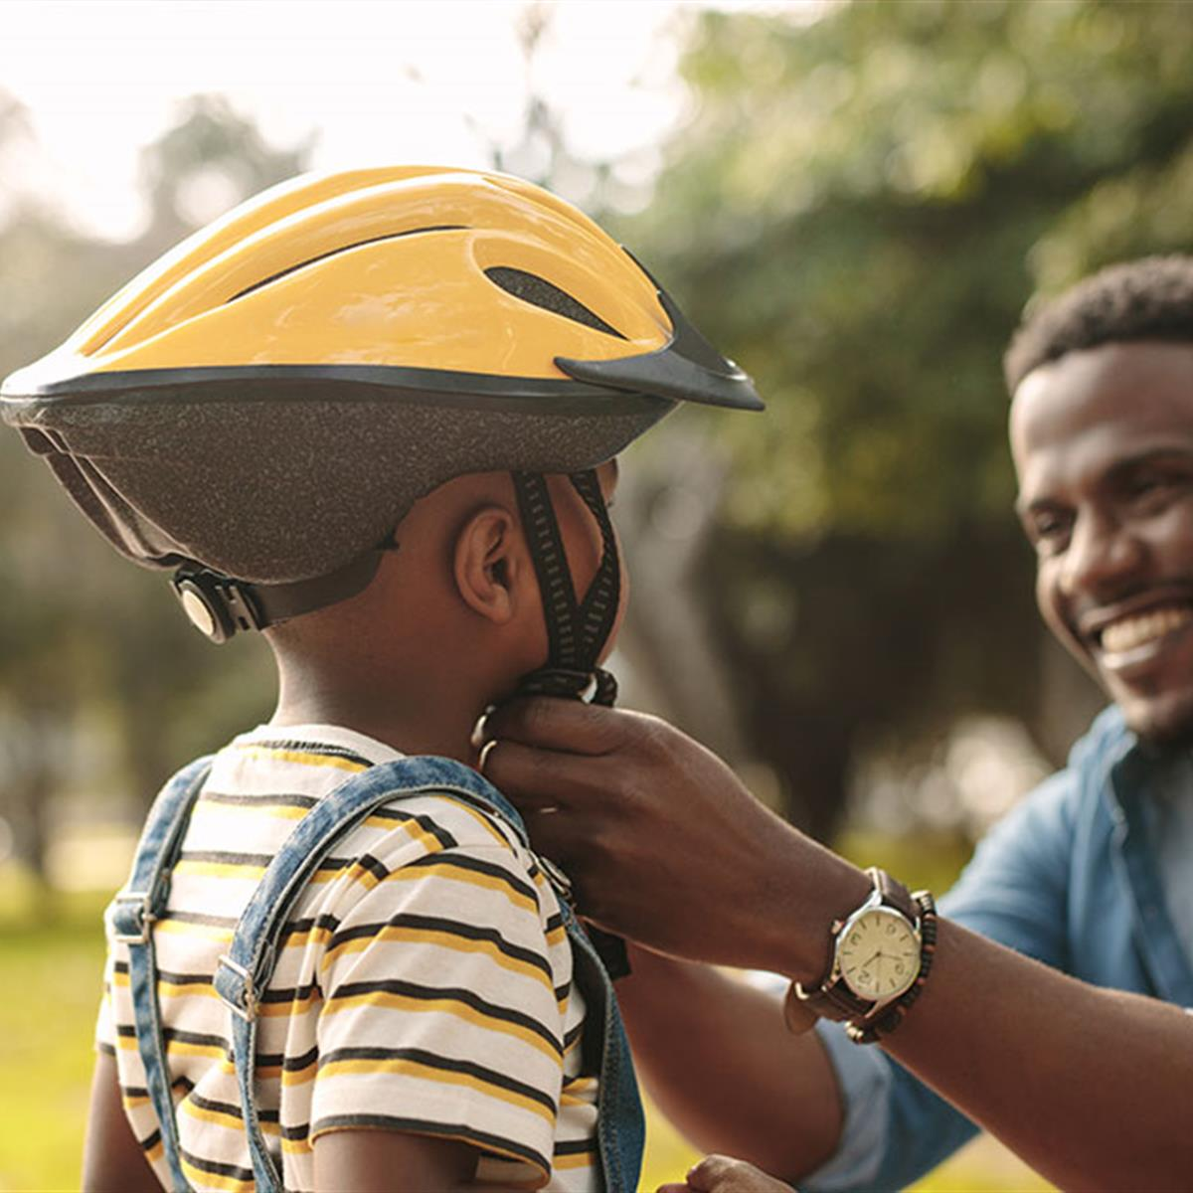
Abstract

Slide 4
Abstract
Motorcycle accidents have been rapidly growing through the years in many countries. In India more than 37 million people use two wheelers. Therefore, it is necessary to develop a system for automatic detection of helmet wearing for road safety. Therefore, a custom object detection model is created using a Machine learning based algorithm which can detect motorcycle riders with helmet. By this system it detects the rider and if the rider with helmet, then it opens the gate and allows the biker for fuel filling. By this system we can avoid the motorcycle accidents and if we keep helmet as a mandatory for rider while filling fuel at petroleum bunks every biker will maintain and wearied with helmet using this caution, we can save the lives and they start following the traffic rules and road safety rules. This Application can be implemented in real-time using a Webcam or a CCTV as input.

Slide 5
Introduction

Slide 6
Introduction
The two-wheeler is a common means of transportation in practically every country. However, due to the lack of safeguards, there is a significant danger associated. The wearing of a helmet by bike riders can significantly lessen the risks they face on the road. Because of the importance of wearing a helmet, governments have made it a crime to ride a bike without helmet.
Now accidents on roads have become a serious concern for all the thousands of people especially youngsters. Transport Ministry road accident report 2021 which stresses the need to tackle this issue as soon as possible seventy-five thousand youngsters died in road accidents last year.

Slide 7
objective

Slide 8
Objective
Our main objective is to develop a system which detects the motorcycle rider with helmet and allows him to fuel filling at pumps of petroleum bunk.
Here we allowing the rider for fuelling after detection of helmet, if helmet detected successfully then the system process the instructions to the Arduino then the gates raised and system allows the biker for fuelling.

Slide 9
scope & Limitations

Slide 10
scope & Limitations
scope
The helmet detection ensures motorcycle rider safety and also takes the necessary steps to reduce accident causality.
We keep helmet as a mandatory for rider while filling fuel at petroleum bunks every biker will maintain and wearied with helmet using this caution.
limitations
We can’t sure that bike rider will wear helmet through-out the ride
Our project detects only riders helmet at petroleum bunks.

Slide 11
Problem definition

Slide 12
Problem Definition
Our main objective is to develop a system which detects the motorcycle rider with helmet and allows him to fuel filling at pumps of petroleum bunk.
Here we allowing the rider for fuelling after detection of helmet, if helmet detected successfully then the system process the instructions to the Arduino then the gates raised and system allows the biker for fuelling.

Slide 13
PROBLEM
MARKET GAP
The Arduino programming language is based on a very simple hardware programming language called processing, which is similar to the C language.
CUSTOMERS
Arduino is an open-source electronics platform based on easy-to-use hardware and software. Arduino boards are able to read inputs - light on a sensor, a finger on a button, or a Twitter message - and turn it into an output - activating a motor, turning on an LED, publishing something online.
FINANCIALS
Millennials account for about a quarter of the $48 billion spent on other products in 2018
COSTS
Loss of productivity costing consumers thousands of dollars

Slide 14
PRODUCT OVERVIEW
UNIQUE
Only product specifically dedicated to this niche market
FIRST TO MARKET
First beautifully designed product that's both stylish and functional
TESTED
Conducted testing with college students in the area
AUTHENTIC
Designed with the help and input of experts in the field

Slide 15
Existing methods

Slide 16
Existing Method
The Existing system monitors the traffic violations primarily through CCTV recordings, where the traffic police have to look into the frame where the traffic violation is happening, zoom into the license plate in case rider is not wearing helmet. But this requires lot of manpower and time as the traffic violations frequently and the number of people using motorcycles is increasing day-by-day.
Hence efficient and feasible techniques have to be created to overcome these problems. Manual surveillance of traffic using a person on roads is an existing methodology.

Slide 17
Data Collection & Performance Metric Study

Slide 18
Data collection
The image get clicked by the traffic police through a camera
Image get verified through a system whether rider with helmet or not
If the rider get detected without helmet then police will make penalty for bike
Viewing of penalty which was done as punishment under law
Notes:
here we have to explain of process which are taken by the traffic police –fining on the number plate so, here we need a system which detects there it self and punishing him for not wering helmet

Slide 19


Performance metrics Study
Metric Study:
Utilizing more of man power
Manual work
Less alert ness
No on spot punishment
Proposed Algorithms:
Tensor Flow
CNN(Convolutional Neural Network)
OpenCV
Existing Algorithms:
No Algorithms because it uses only manual work
Notes:
“No on spot punishment “means if we make fines they neglect and say that “are they will fine us in online and we can pay fine after” if we punish there it self next they don’t neglect
TensorFlow is an open source framework developed by Google researchers to run machine learning, deep learning and other statistical and predictive analytics workloads.
CNN is used to detect the helmet of the rider or it mainly used to detect the specified object

Slide 20
PRODUCT OVERVIEW
UNIQUE
Only product specifically dedicated to this niche market
FIRST TO MARKET
First beautifully designed product that's both stylish and functional
TESTED
Conducted testing with college students in the area
AUTHENTIC
Designed with the help and input of experts in the field

Slide 21
PRODUCT BENEFITS
Cool and stylish product
Areas for community connections
Online store and market swap

Slide 22
COMPANY OVERVIEW

Slide 23
BUSINESS MODEL
ABSTRACT
We based our research on market trends and social media
DESIGN
We believe people need more products specifically dedicated to this niche market
RESEARCH
Minimalist and easy to use

Slide 24
MARKET OVERVIEW
$3 Billion
$1 Billion
$2 Billion
Freedom to invent
Selectively inclusive market
Serviceable available market
Opportunity to build
Fully inclusive market
Total addressable market
Few competitors
Specifically targeted market
Serviceable obtainable market

Slide 25
Market comparison
$3B
$2B
$1B
Opportunity to build
Freedom to invent
Few competitors
Addressable market
Serviceable market
Obtainable market

Slide 26
OUR COMPETITION
CONTOSO
COMPETITORS
Our product is priced below that of other companies on the market
Design is simple and easy to use, compared to the complex designs of the competitors
Affordability is the main draw for our consumers to our product
Company A Product is more expensive
Companies B & C Product is expensive and inconvenient to use
Companies D & E Product is affordable, but inconvenient to use

Slide 27
Our competition
Convenient
Contoso
Competitor A
Affordable
Expensive
Competitor D
Competitor C
Competitor B
Competitor E
Inconvenient

Slide 28
Growth strategy
Feb 20XX
Roll out product to high profile or top-level participants to help establish the product
Mar 20XX
Release the product to the general public and monitor press release and social media accounts
Oct 20XX
Gather feedback and adjust product design as necessary

Slide 29
TRACTION
Forecasting for success
Key Metrics
 | Clients | Orders | Gross revenue | Net revenue
20XX | 10 | 1100 | $10,000 | $7,000
20XX | 20 | 200 | $20,000 | $16,000
20XX | 30 | 300 | $30,000 | $25,000
20XX | 40 | 400 | $40,000 | $30,000
REVENUE BY YEAR

Slide 30
TWO-YEAR ACTION PLAN
DRAFT BLUEPRINTS
GATHER FEEDBACK
DELIVER TO CLIENT
20XX
JAN
FEB
MAR
APR
MAY
JUN
JUL
AUG
SEP
OCT
NOV
DEC
20XX
JAN
FEB
MAR
APR
MAY
JUN
JUL
AUG
SEP
OCT
NOV
DEC
RUN FOCUS GROUPS
TEST DESIGN
LAUNCH DESIGN

Slide 31
FINANCIALS
 | Year 1 | Year 2 | Year 3
INCOME
Users | 50,000 | 400,000 | 1,600,000
Sales | 500,000 | 4,000,000 | 16,000,000
Average price per sale | 75 | 80 | 90
Revenue @ 15% | 5,625,000 | 48,000,000 | 216,000,000
GROSS PROFIT | 5,625,000 | 48,000,000 | 216,000,000
Expenses
Sales & marketing | 5,062,500 | 38,400,000 | 151,200,000 | 70%
Customer service | 1,687,500 | 9,600,000 | 21,600,000 | 10%
Product development | 562,500 | 2,400,000 | 10,800,000 | 5%
Research | 281,250 | 2,400,000 | 4,320,000 | 2%
TOTAL EXPENSES | 7,593,750 | 52,800,000 | 187,920,000

Slide 32

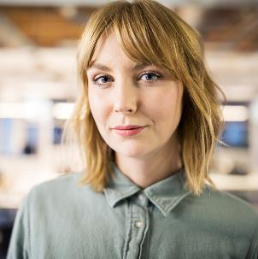


MEET THE TEAM
TAKUMA HAYASHI​
MIRJAM NILSSON​
FLORA BERGGREN​
RAJESH SANTOSHI​
President
Chief Executive Officer
Chief Operations Officer
VP Marketing

Slide 33


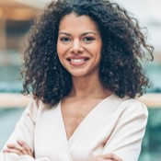


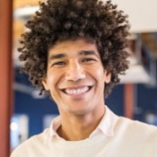


MEET THE TEAM
TAKUMA HAYASHI
MIRJAM NILSSON​
FLORA BERGGREN​
RAJESH SANTOSHI
President
Chief Executive Officer
Chief Operations Officer
VP Marketing
GRAHAM BARNES
ROWAN MURPHY
ELIZABETH MOORE
ROBIN KLINE
VP Product
SEO Strategist
Product Designer
Content Developer

Slide 34
FUNDING
$14,000
$12,000
$82,000
$32,000
ANGEL INVESTMENTS
PROPERTY
SHARES
CASH
Amount obtained through other investors
Revenue obtained from property rentals
Number of shares converted into USD
Liquid cash we have on hand

Slide 35
conclusion
The proposed system aims to prevent motorcycle accidents and also reduce the fatality of accidents. Machine learning algorithm and IOT based model has high accuracy and automatically detects the helmet and mediately it give response like lifting the gates for fueling.
This system makes a habit to wear a helmet among motorcycle riders. The helmet would make a motorcycle journey more protected and safer.

Slide 36
Thank you
Team 05​

